Slide 1
Profile Highlights
Lake County Highlights
16% growth in enrollment (Plan 20%)
Majority members White-Non Hispanic (60%)
County Health Ranking indicates many social, economic and health challenges, robust community improvement coalition
Primary care visit rate above the Plan average, with 20% of primary care visits provided via telehealth.
Highest specialty visit rate in the 14-county region. 47% increase since 2015
ED use rates above the Planwide Ave.
37% increase in use of Behavioral Health visits for children since 2018
Need for continued focus on child and adult health metrics
COVID Vaccination rates 18% below Planwide Ave.
Table of Contents:
Enrollment & Ethnicity
Health Status
Quality Metrics
Utilization Trends
Member & Provider Satisfaction

Slide 2
Enrollment Trends 2014 – 2022
Plan and Lake County
Enrollment in Lake County has increased by 16% since January 2020 Compared to 20% Planwide

Slide 3
Member Ethnicity Profile Southern Region
Majority People of Color
Majority White Non-Hispanic
Enrollment as of January 2022
Notes:
Speaker: Present by region left to right

Slide 4
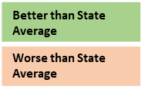
County Health Status
County | Health Ranking (2022) | Adult Smoking (2019) | Teen Births Per 1000 Females 15-19/Yr (2014-2020) | Children Living in Poverty (2020) | Drug Overdose Deaths Per 100,000 Pop. (2018-2020) | Life Expectancy (2018-2020)
Marin | 1 | 10% | 6 | 6% | 17 | 85.2
Napa | 5 | 11% | 10 | 9% | 13 | 82.1
Sonoma | 8 | 11% | 10 | 9% | 22 | 82
Yolo | 12 | 12% | 7 | 11% | 12 | 81.4
Solano | 22 | 12% | 15 | 11% | 18 | 80
Mendocino | 44 | 15% | 22 | 19% | 44 | 78.5
Lake | 56 | 17% | 30 | 22% | 71 | 74.8
California | 58 Counties | 10% | 16 | 15% | 14 | 81.7
Summary of three regions – county health ranking + five key metrics
Year of Life Lost
Percent Poverty
Single parent families
XXX
Source: RWJ County Health Ranking 2022
Notes:
Speaker: Dr. Kubota

Slide 5
Child Health Spotlight Southern Region QIP Results for 2021
Measure | Partial Pt Target | Full Point Target | Plan 2021 | Lake County | Marin County | Mendo County | Sonoma County | Napa County | Solano County | Yolo County
Child/Adolescent Visits | N/A | 47.5% | 50.5% | 47.0% | 47.3% | 48.3% | 58.2% | 58.1% | 43.5% | 59.4%
Asthma Medication Ratio | 63.6% | 68.5% | 62.9% | 52.9% | 75.7% | 60.7% | 65% | 74.1% | 69.4% | 70.8%
Childhood Immunization CIS10 | 34.8% | 42.0% | 31.3% | 32.5% | 42.3% | 35% | 37.5% | 32.9% | 32.7% | 43%
Adolescent Immunizations | 34.4% | 40.4% | 35% | 32.5% | 35.5% | 28% | 45.5% | 53.5% | 40% | 37.3%
Nutrition Counseling | N/A | 70.9% | 70.5% | 50.4% | 73% | 73.7% | 73.5% | 93.7% | 56.6% | 98.4%
Physical Activity Counseling | N/A | 65.0% | 67.8% | 44.7% | 72.2% | 69.1% | 72.5% | 82% | 57% | 98.2%
Well Child - 1st 15 Months | 65.8% | 69.8% | 53.4% | 48.4% | 48.7% | 63.4% | 65.9% | 40.6% | 44.4% | 60%
Lead Screenings/1000 |  |  | 150 | 142 | 264 | 194 | 137 | 189 | 133 | 210
Dental Fluoride Varnish |  |  | 19.9 | .6 | 6.7 | 22.9 | 18.8 | 3.0 | 34.8 | 12.5
Development Screening |  |  | NA | 31 | 628 | 599 | 722 | 12 | 891 | 485
Index
At or Above Full Points (75th or 50th percentile)
At or Above Partial Points (50th percentile)
At or Above Plan Average
Below MPL & Below Plan Average

Slide 6
Adult Health Spotlight Southern Region QIP Results for 2021
Measure | Partial Pt Target | Full Point Target | Plan 2021 | Lake County | Marin County | Mendo County | Sonoma County | Napa County | Solano County | Yolo County
Asthma Medication Ratio | 63.6% | 68.5% | 62.9% | 52.9% | 75.7% | 60.7% | 65.9% | 74.1% | 69.4% | 70.8%
Breast Cancer Screening | 58.7% | 64.0% | 49.5% | 43.4% | 49% | 48.9% | 57% | 53.8% | 50.8% | 53.2%
Cervical Cancer Screening | 60.7% | 66.5% | 57.9% | 54.2% | 69% | 59.7% | 68.8% | 62.7% | 53% | 62.3%
Colorectal Cancer Screening | 32.2% | 41.8% | 40.1% | 40% | 43.2% | 39.6% | 42.3% | 41.7% | 37% | 44.7%
Controlling High Blood Pressure | 61.0% | 66.9% | 63.6% | 62.9% | 68% | 51.9% | 73.2% | 60% | 64.3% | 55.7%
Diabetes - HbA1c Control | 61.5% | 67.2% | 65.2% | 58.4% | 67.5% | 59.5% | 68.6% | 61.8% | 66.3% | 67.5%
Index
At or Above Full Points (75th or 50th percentile)
At or Above Partial Points (50th percentile)
At or Above Plan Average
Below MPL & Below Plan Average

Slide 7
Planwide Primary Care Visit Trends
2018 - 2021
25% decline in primary care visits per member per year due to COVID. Recovery in process.

Slide 8
County Primary Care Visit Rates &
Use of Telehealth - 2021
24%
42%
32%
39%
17%
20%
30% of primary care visits were provided via telehealth in 2021. Use varies by county

Slide 9
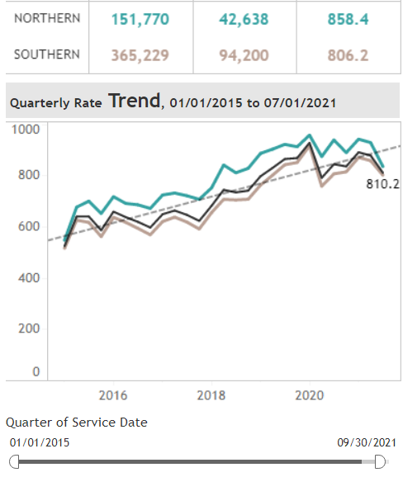
Planwide Specialty Care Visit Trends
CY 2021
Visits Per 1000 Members Per Year*
Specialty Visit Facts
Visit Rate/1000 Mbr/Yr (including Behavioral Health) | 821
Percent Members Using Specialty Services | 25%
Average Visits per User | 3.8
Percent Referrals resulting in a Visit | 60%
Average Days between Referral and Visit | 43
Percent Visits Provided Via Telehealth | 34%
COVID Impact

Slide 10
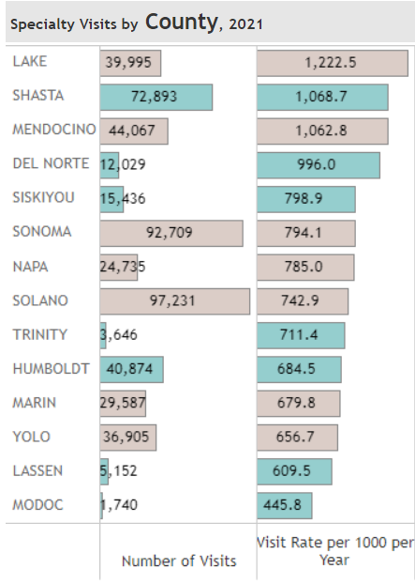
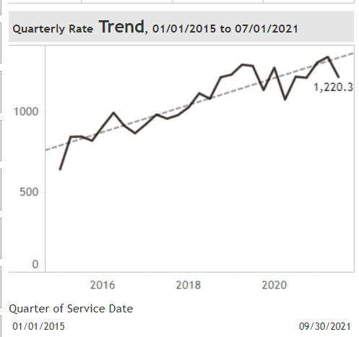
County Specialty Care Visit Trends
2021
Visits Per 1000 Members Per Year
Lake County Specialty Visit Rates 2015 - 2021
COVID Impact
Lake Cty Average Days to Specialty Appointment: 40 Days (Plan Ave. 43 /days)
47% Increase in specialty visit rate since 2015

Slide 11
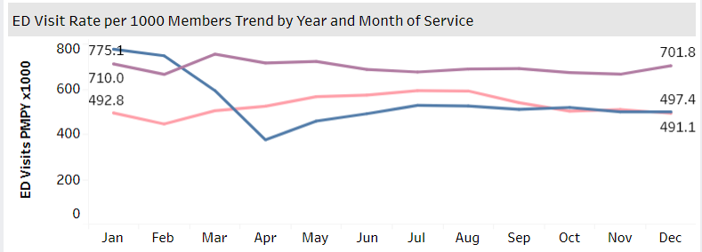
Planwide ED Use Trends
2019 – 702 Visits/1000
2020 – 497 Visits/1000
2021 – 491 Visits/1000
30% decline in ED use during COVID-19 Pandemic
Compared with Pre-Pandemic Levels

Slide 12
County ED Use Trends
ED Visits/1000 Mbrs/Year in 2021
Plan Average: 528
Lake County has second highest ED use rate in Region
2021 shows 26% reduction from pre-COVID rate

Slide 13
COVID Vaccination Rates Southern Region - County and Plan

Slide 14
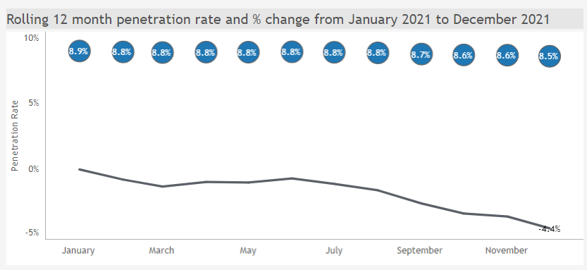
Behavioral Health Use (All Ages)
Year | Percent Users
2018 | 9%
2019 | 10%
2020 | 9%
2021 | 8%
Between 8.5 – 8.9% of of Partnership HealthPlan Members Used One or More Behavioral Health Services In 2021
Provider Type | Visits 2021 | Percent of Total Visits | Percent Visits Via Telehealth | Ave. Visits per Member
Therapy Services | 345,425 | 76% | 20% | 12.6
Medical Management | 46,862 | 10% | 49% | 4.2
Other | 62,355 | 14% | 20% | 7.5

Slide 15
Behavioral Health Use: Adults (21+)
Plan and County

Slide 16
Behavioral Health Use: Children (<21)
Plan & County
Lake County Data for 2021 – Children < 21
Visits | Users | Average Visits/User
4,756 | 500 | 9.5 Visits

Slide 17
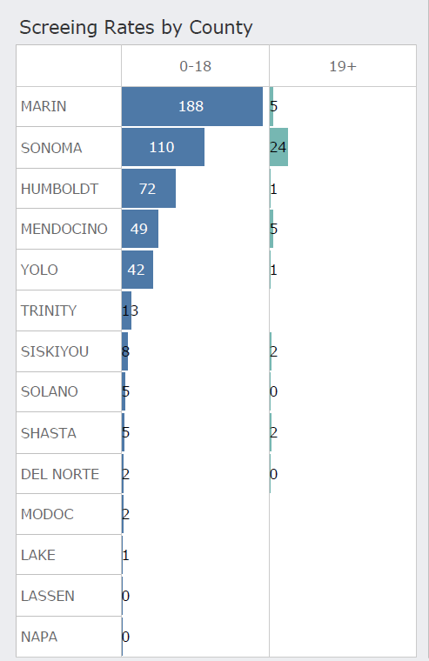
ACE’s Screenings
Children & Adults 2021
Plan & County
Screening Rates by County
Top Performers Children Screenings (Per 1000 Mbrs/Year) |  | Top Performers Adults Screenings (Per 1000 Mbrs/Year)
Sonoma Plaza Peds | 652 | Sonoma Valley Ctr | 205
Martha Cueto Salas | 452 | West Sac Pediatrics | 107
West Sac Pediatric | 410 | Baechtel Creek | 98
Mendocino Coast Cln | 287 | Sonoma Plaza Med | 78
Mendocino Coast Ped | 279 | Lassen Med Cln | 66
Marin CC Novato | 208 | SRCH Vista | 34
Planwide | 50 | Planwide | 5

Slide 18
Blood Lead Screenings (SR)
Children 1 – 2 Years in 2021
Plan & County
New QIP Unit of Service Measure for 2022
Screening Rates by County
Per 1000 Children, Age 1 to 2
Planwide 2021
4,201 Children Screened for Blood Lead | 4,612 Blood Lead Tests | 390.9 Children Tested PMPY x 1000
Top Performers for Children Screenings (Per 1000 Mbrs/Year)
Marin Community Clinic San Rafael | 906
Marin Community Clinic South Novato | 935
Marin Community Clinic Campus | 871
Woodland Clinic | 639
MCHC Hillside | 588
Planwide | 390

Slide 19
Developmental Screenings 2020 Plan & County
New State Measure for 2023
The American Academy of Pediatrics Recommends Developmental Screenings start at age 9 months, with follow-up at ages 18, 24 or 30 months. Prop 56 provides supplemental funding of $59.90 for each screening completed.

Slide 20
Fluoride Dental Varnish
2019 and 2020 Plan & County
New QIP Unit of Service Measure for 2022
County | Estimate of Eligible Children | Dental Fluoride Varnish Claims
 |  | 2019 | 2020
Lake | 8,531 | 15 | 5
Marin | 1.186 | 10 | 8
Mendocino | 11,917 | 39 | 273
Napa | 1.644 | 4 | 5
Solano | 27,147 | 986 | 946
Sonoma | 23,720 | 2,224 | 445
Yolo | 16,604 | 228 | 208
Plan | 114,216 | 4,288 | 2,277
USPFTF recommends application of fluoride dental varnish from eruption to 5 years of age. Application 2 – 3 times per year.

